Slide 1
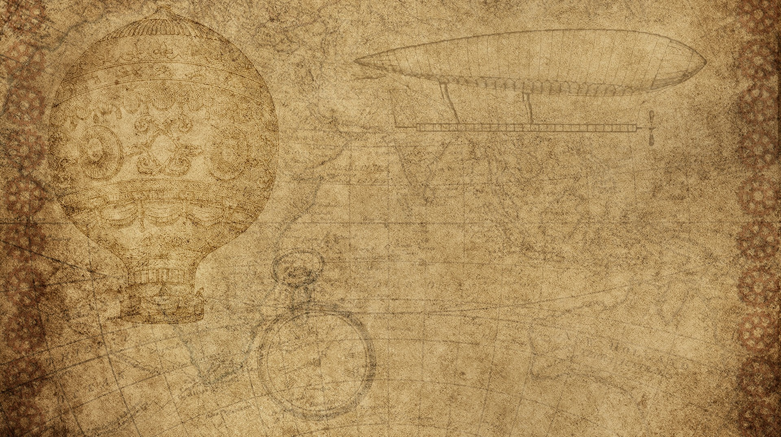
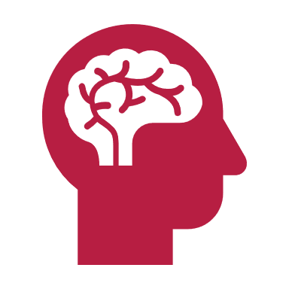

SIT792 – Minor Thesis
A Transparent Marking System over a Distributed Ledger
Edwin John Nadarajan 218599279
Team 2
Supervisor: Dr. Rolando Trujillo

Slide 2

Why This Research?
Problems with the existing online examination marking systems:
Requirement of trust.
Marking can be fiddled with.
My proposal:
Blockchains for transparency.
Smart contract for reliability.

Slide 3
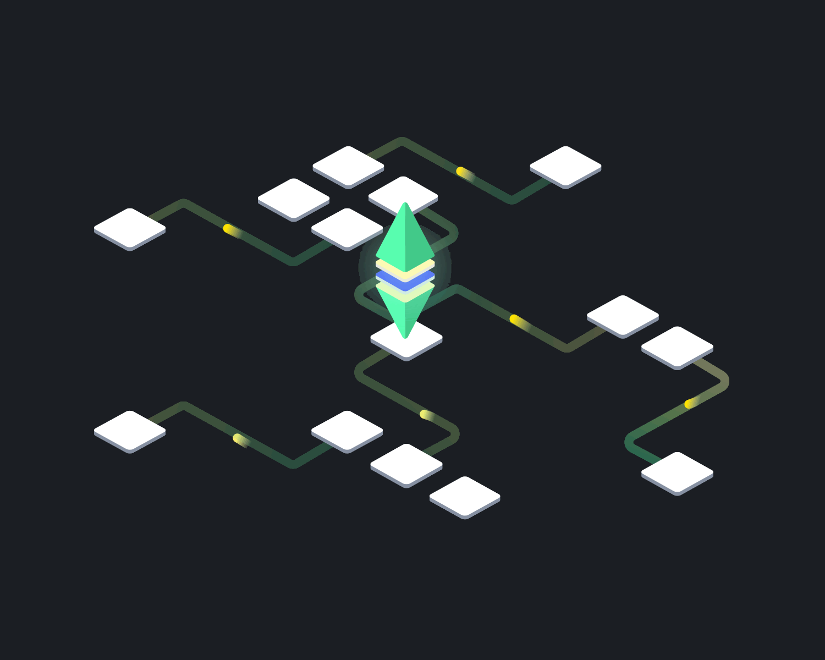
What is blockchain and why use it?
Public distributed ledger (transparency)
Uses cryptography for immutability
Stores data as well as programs (smart contracts)
Eliminates need for 3rd party in marking process.
Image source: SocialPreneur-PodcastDe

Slide 4

Key research questions
How do the existing online quiz examination systems work and where do they all lack?
How does the proposed system tackle the problems present in the existing system?
What will the proposed system look like and how will it work?
Methodology: Quantitative and Applied Research
Notes:
Transparency and Decentralization of online quizzing are the main concerns of this research project. The primary
questions addressed are:
• How do the existing online quiz examination systems work and where do they all lack?
• How does the proposed system tackle the problems present in the existing system?
• What will the proposed system look like and how will it work?
I will be using quantitative research in the context of applied research to go through existing online quizzing systems,
find gaps in them and fit in my ideas to solve problems.

Slide 5
QuizzEth
Existing systems are either susceptible to bias or suffer from the limitations of blockchain.
Large number of papers were analyzed, summarized and drawn inference from.
A system which blends the advantages of centralized and decentralized systems along with community-based platforms into online quizzing.
Notes:
Most online quiz systems are centralized around an institutional server. They are susceptible to biased results or even hacking.
Some quiz systems incorporated blockchain technology to counter this but failed to tackle its limitations.
After reading around 20 carefully selected papers, summarizing and drawing inferences from them, I came up with a system
which blends the advantages of centralized and decentralized systems along with community-based platforms into online quizzing.
This system is called QuizzEth.
With QuizzEth, a large number of students and instructors across the world can form a community to share and test their knowledge online
without worrying about the tampering of results; maintaining the transparency of the system. It runs on MERN stack along with Web3js and Solidity.

Slide 6
RESULTS
Anyone can contribute knowledge.
Better knowledge increases reputation.
False information decreases reputation.
Quizzes based on topics and time.
Notes:
In QuizzEth, anyone can contribute knowledge in the form of an interchange (pair of question and answer).
Good knowledge will receive more upvotes; increasing the reputation of the individual who posted it whereas false knowledge will receive downvotes;
decreasing the reputation of the user. This will encourage the users to contribute with integrity and to put their best efforts out there.
Also, the system collects such interchanges based on a user’s topic and time requirements to generate a quiz with tamper-proof results.
Better result also increases the reputation of the user.
This mechanism of combining reputation, community, knowledge and blockchain together seems to work out very well for students as well as instructors.

Slide 7
THANK YOU!

